Slide 1
Problem
Consider a perceptron with a ReLU as activation function designed to process a single-dimensional inputs x.
Draw the computational graph of the perceptron, drawing a circle around the parameters that need to be estimated during training.
Compute the partial derivative of the output of the perceptron (y) with respect to each of its parameters for the input sample x=2. Consider that all the trainable parameters of the perceptron are initialized to 1.
Modify the results obtained in b) for the case in which all the trainable parameters of the perceptron are initialized to -1.
Briefly comment and compare the results obtained in b) and c).

Slide 2
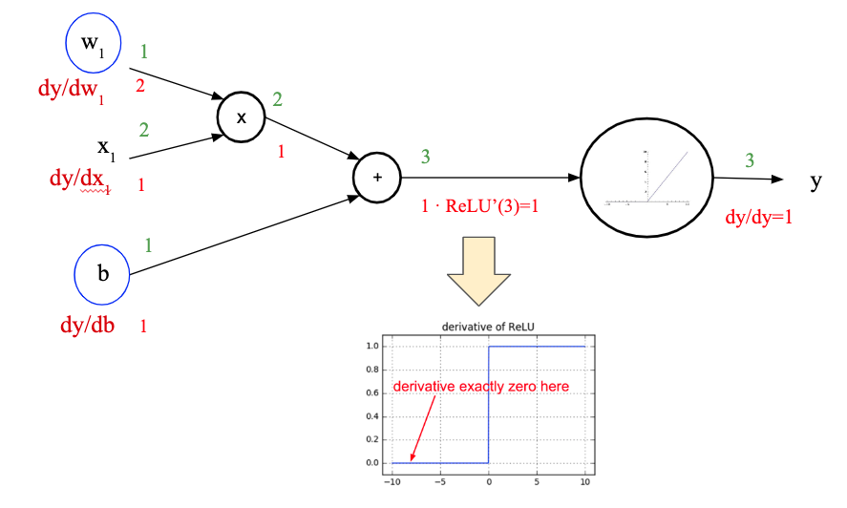
Problem (solution)
Draw the computational graph of the perceptron, drawing a circle around the parameters that need to be estimated during training.
Compute the partial derivative of the output of the perceptron (y) with respect to each of its parameters for the input sample x=2. Consider that all the trainable parameters of the perceptron are initialized to 1.

Slide 3
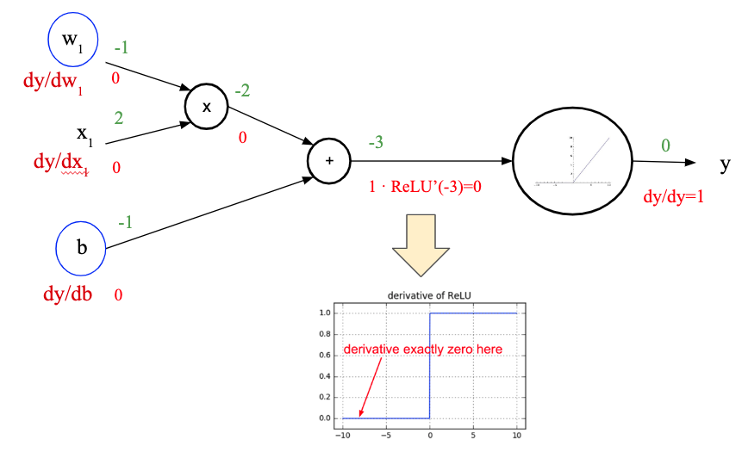
Problem (solution)
￼
￼
c) Modify the results obtained in b) for the case in which all the trainable parameters of the perceptron are initialized to -1.
d) Briefly comment and compare the results obtained in b) and c).
d) While in case b) the gradients can flow until the trainable parameters w₁ and b, in case c) gradients are “killed” by the ReLU.

